Slide 1
City Weather Data Parser: A Mobile Application For Displaying Weather Information From XML And JSON
SlideMake.com

Slide 2
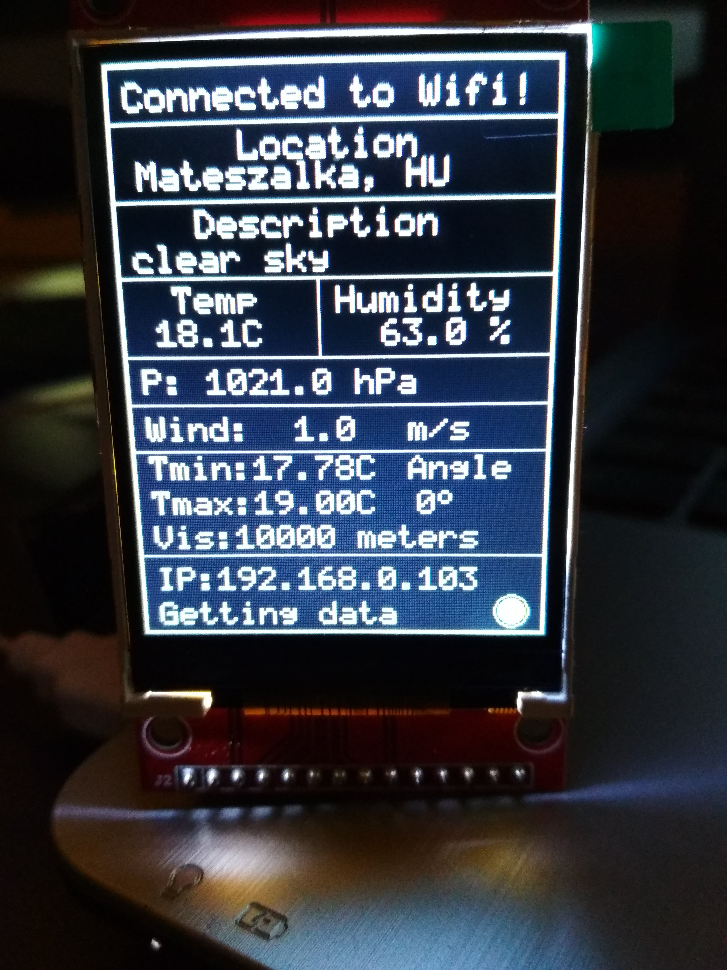
Introduction to City Weather Data Parser
The City Weather Data Parser is a mobile application designed to provide real-time weather information.
It efficiently parses weather data from both XML and JSON formats to ensure compatibility with various data sources.
Users can access current weather conditions, forecasts, and historical data through a user-friendly interface.
Notes:
Image source: https://www.instructables.com/Esp8266-Weather-Data-Parser-Openweathermap/

Slide 3
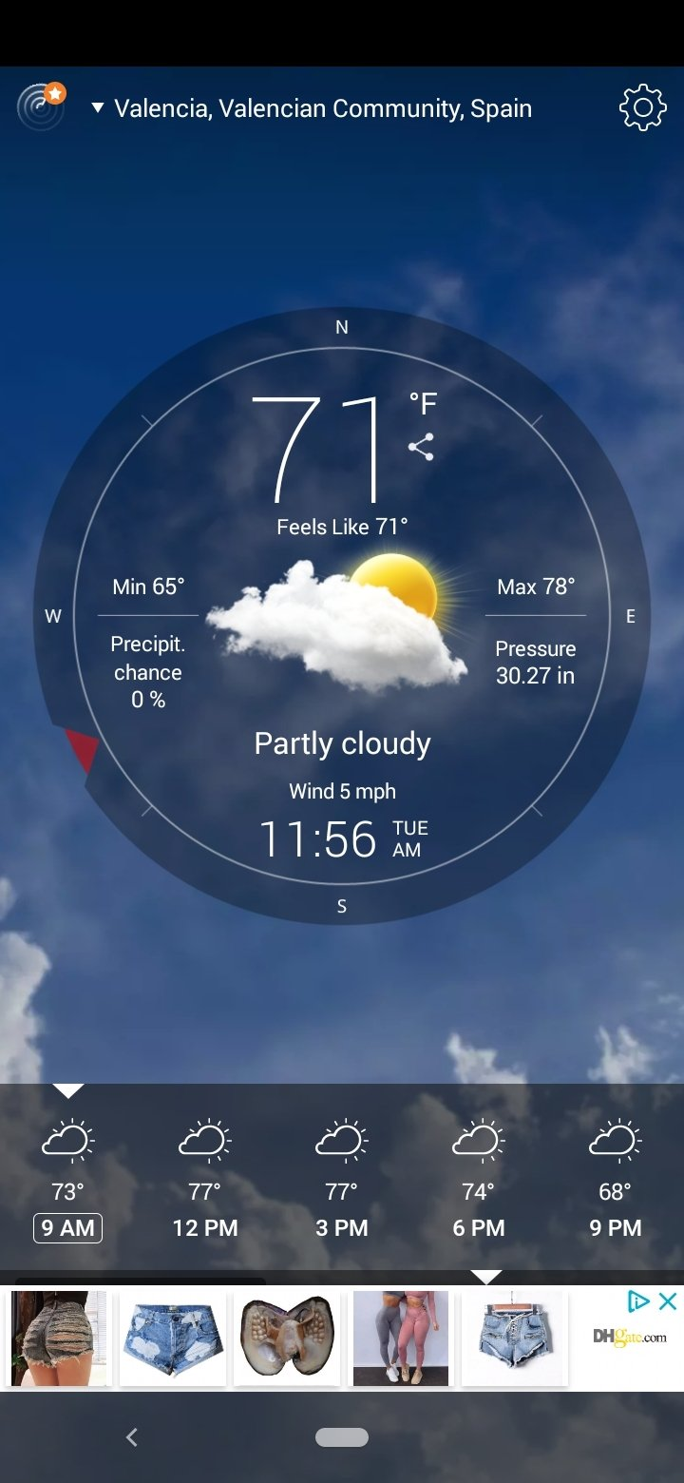
Application Features
The application offers a simple and intuitive navigation system for easy access to weather information.
Users can customize their experience by selecting preferred cities and weather metrics to display.
Notifications for severe weather alerts can be enabled to keep users informed of important updates.
Notes:
Image source: https://www.malavida.com/en/soft/weather-live/android/

Slide 4

Data Sources and Formats
The City Weather Data Parser supports multiple APIs that provide weather information in XML and JSON formats.
XML is often used for structured data, while JSON is favored for its lightweight nature and ease of use.
This dual support ensures that the application can connect to a wide array of weather services.
Notes:
Image source: https://www.credly.com/org/ibm/badge/environmental-intelligence-suite-data-services-weat

Slide 5
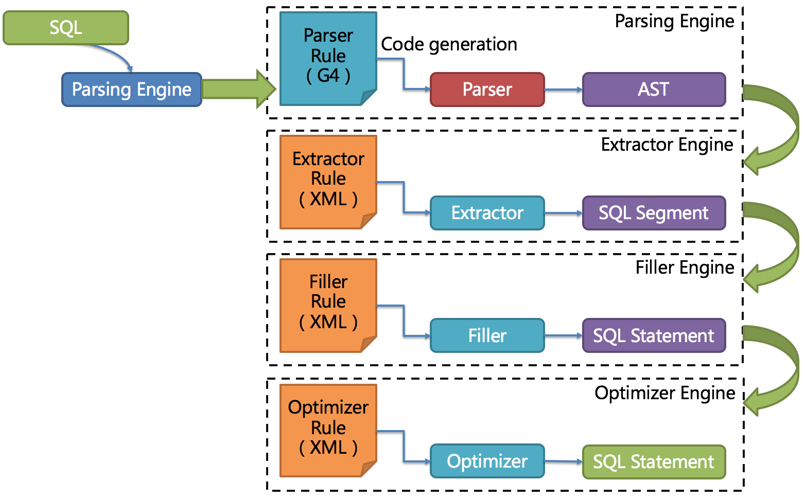
Parsing Mechanism
The application employs a robust parsing engine to extract relevant data from XML and JSON responses.
It utilizes libraries that simplify the parsing process and improve performance efficiency.
Error handling mechanisms are in place to manage data inconsistencies and ensure reliable user experience.
Notes:
Image source: https://shardingsphere.apache.org/document/legacy/3.x/document/en/features/sharding/principle/parse/

Slide 6
User Interface Design
The user interface is designed with a focus on simplicity and accessibility for all users.
Visual elements such as icons and graphics enhance the experience and provide quick comprehension of data.
The layout is optimized for both smartphones and tablets, ensuring versatility across devices.
Notes:
Image source: https://creative-daddy.com/p/1473415

Slide 7
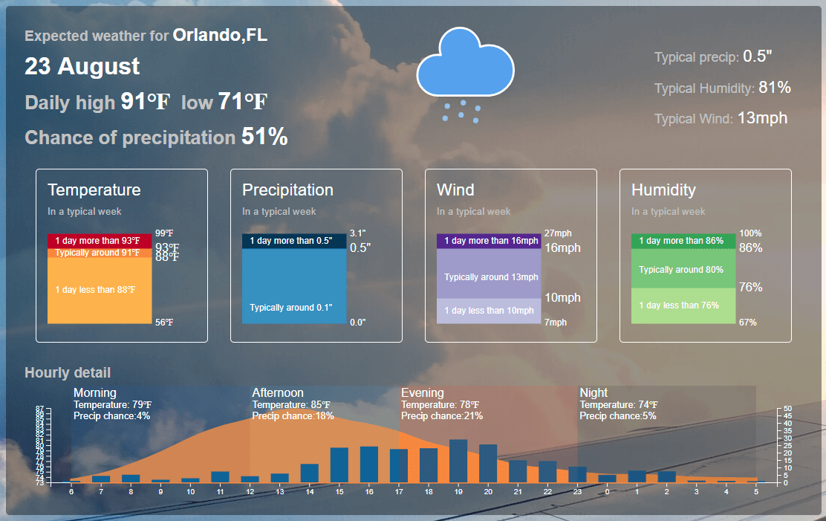
Current Weather Display
Users can view real-time weather conditions, including temperature, humidity, and wind speed.
Detailed descriptions and icons provide a clear representation of current weather conditions.
The option to refresh data allows users to get the latest updates with a simple tap.
Notes:
Image source: https://maporegoncoaststateparks.pages.dev/new-cwdmv-a-global-view-understanding-the-power-of-real-time-weather-data-idiyz-pics/

Slide 8
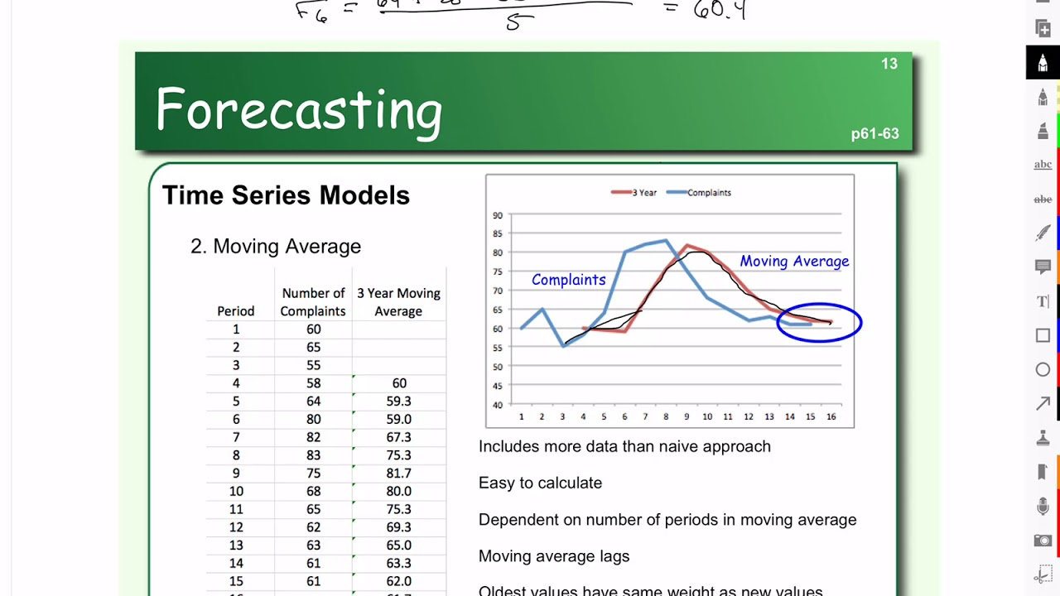
Forecasting Capabilities
The application provides short-term and long-term weather forecasts for selected cities.
Users can view hourly and daily forecasts, allowing for better planning of activities.
The forecast data includes various metrics, such as precipitation and UV index, for comprehensive insights.
Notes:
Image source: https://www.youtube.com/watch?v=EVnLggnaxZc

Slide 9
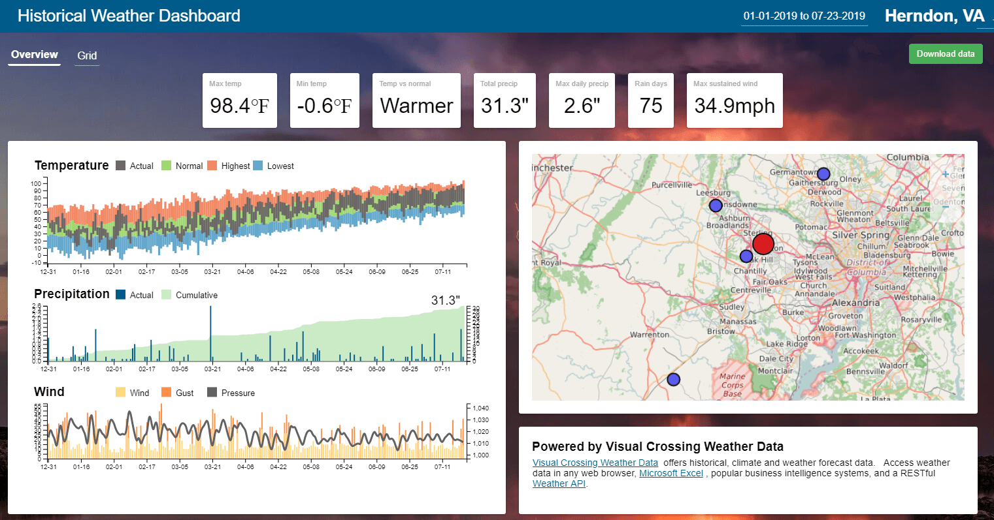
Historical Weather Data
Historical weather data is accessible, allowing users to analyze past weather trends.
This feature is useful for research, planning events, or understanding seasonal changes.
Users can filter historical data by date range and specific weather metrics for targeted insights.
Notes:
Image source: https://www.visualcrossing.com/resources/blog/historical-weather-data-for-everyone/

Slide 10

Performance and Optimization
The application is optimized for speed, ensuring quick loading times and responsive interactions.
Regular updates and maintenance keep the application running smoothly and securely.
User feedback is actively sought to identify areas for improvement and enhance functionality.
Notes:
Image source: https://www.headspin.io/blog/android-app-performance-optimization

Slide 11
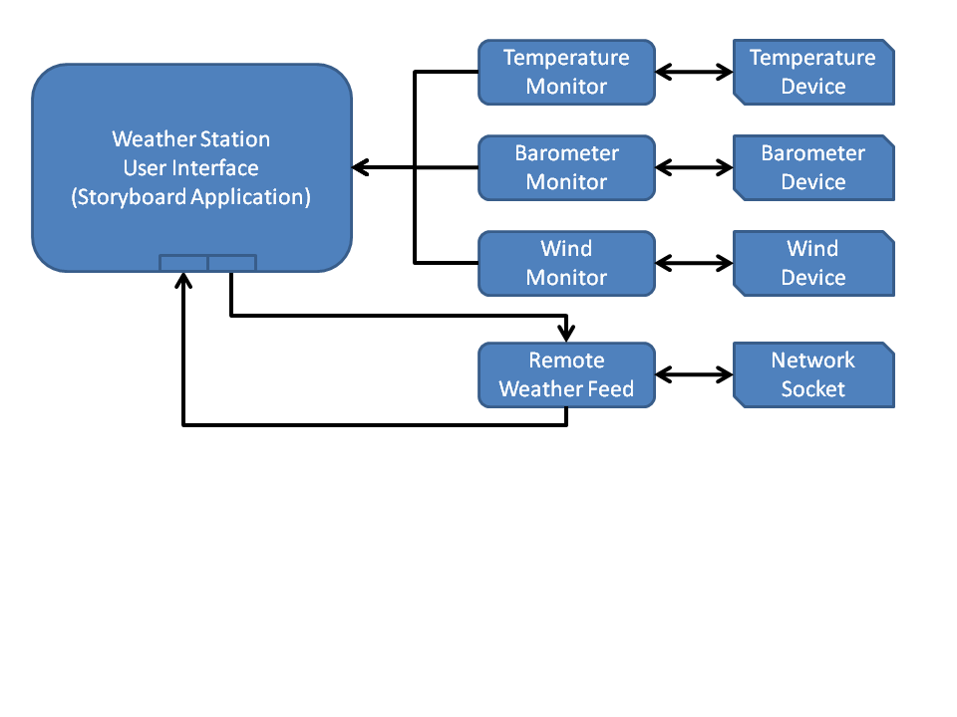
Conclusion and Future Developments
The City Weather Data Parser aims to be a leading mobile application for weather information.
Future developments may include machine learning algorithms for predictive analytics and enhanced personalization.
Continuous integration of new data sources will keep the application relevant and informative for users.
Notes:
Image source: https://blog.cranksoftware.com/weather-station-part-2-system-architecture/

